Slide 1
Taenia solium (pork tapeworm)
Mamita rai Gurung

Slide 2
There are two important human pathogens in the genus Taenia :T.solium and T. seginata
T. solium is the causes gastrointestinal infection
T. solium exist in the two forms adult and larvae form
The adult form of Taenia solium cause taeniasis and larval form cause cysticercosis

Slide 3
Morphology:
It is an intestinal zoonotic parasite found throughout the world,
Most prevalent in countries where pork is eaten.
The adult worm is found in humans and has a flat ribbon-like body, which is white in color and measures 2 to 3 metres in length.
It’s distinct head called scolex contains suckers and rostellum as organs of attachment. The main body called strobila consists of a chain of segments known as proglottids. Each proglottid is a complete reproductive unit, hence, the tapeworm is hermaphrodite. It completes its life cycle in human, as definitive host, and pigs, as intermediate host.

Slide 4
It completes its life cycle in two hosts : intermediate host- pig
Definitive host- humans.
From humans the eggs are released in the environment where they await ingestion by another host. Humans as the definitive hosts are directly infected from contaminated meat.

Slide 5
Definitive host
Humans are infected by the larval stage called cysticercus from a measly pork. A cysticercus is oval-shaped containing inverted scolex (specifically "protoscolex").
This larva attach to the gut wall and grows into mature adult worm containing numerous proglottids.
A single gravid proglottid can contain more than 50,000 embryonated eggs. Gravid proglottids often rupture in the intestine liberating the eggs in faeces.
The free eggs and detached proglottids are released into the environment through faeces.Eggs can survive in the environment for up to two months.

Slide 6
Intermediate host
Pigs ingest the eggs and detach preglottids from human faeces or vegetation contaminated with human excreta.
In pigs intestine a six hooked embryo (oncosphere) emerge from each egg. These embryoes are then carried to the skeletol muscle via blood vessel where they develop into cysticerci. So when human consume this pork meat, they get infected with this cysticerci larva contained in the pork muscle.
But, if humans ingest the eggs from contaminated food or water then these eggs hatch in small intestine of humans releasing oncospores which can disseminate to many organs like eyes and brains via blood vessel. In such organs, the oncospores encyst to form cysticerci larva.

Slide 7
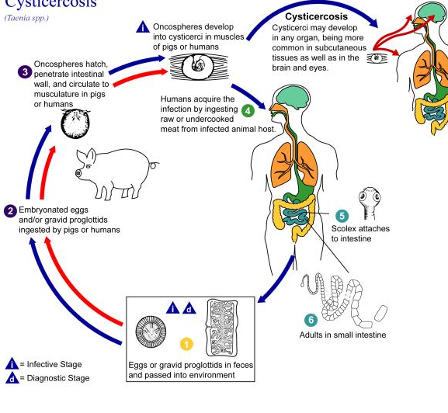

Slide 8
Pathogenesis
The adult tapeworm attached to the intestinal wall causes little damage. The cysticerci on the other hand can become very large especially in the brain where they manifest as a space occupying lesion. Living cysticerci do not cause inflammation, but when they die they can release substances that provokes an inflammatory response.

Slide 9
Transmission
Humans are infected by consumption of raw or undercooked pork containing larva called cysticerci.
Sometimes through faecal oral route.

Slide 10
Clinical manifestation:-
Most patient with adult tapeworm are asymptomatic. But anorexia and diarrhoea can occur.
The most severe form is neurocysticercosis, which affects the brain and is a major cause of epilepsy.
Cysatercercosis in the brain causes headache , coma, vomitting and seizure
Cystecercosis in the eye can appear as uveitis or retenitis or the larva can be visualized floating in the vitreous.
Subcutaneous nodule commonly occur.

Slide 11
Lab diagnosis:
Sample:-Stool
Finding gravid proglottids with 5-10 uterine branches in stool.
Eggs are also found in stool.
Cysticercosis is diagnosed by demonstrating cyst in tissue by x-ray or by CT scan

Slide 12
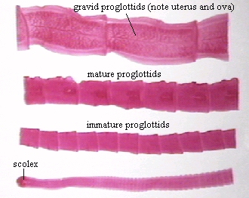

Slide 13
Treatement: Praziquantel, Albendazole
Prevention and control: adequate cooking of pork, proper disposal of waste so that pigs cannot ingest the human faeces, proper hygiene, hand washing, prevent contamination of food with eggs.

